Slide 1
World Happiness Report
Jie ji
Hui Du
Danxi Wu
Jianjian Liu
Kachun Lee
Donghao Liu

Slide 2
Introduction
Background
The World Happiness Report is a landmark survey of the state of global happiness
Happiness Score: national average of the responses to the main life evaluation question asked in the Gallup World Poll
We used Visualization, Regression, ANOVA, and Hypothesis Test in this project.

Slide 3
Data:
By Helliwell, John et al., available on Kaggle(Aché).
Data files contains reports from year 2015 to 2021
Each file - Happiness Score, GDP per capita, Healthy Life Expectancy, Social Support, Freedom to make life choices, Generosity, Corruption Perception, Residual error, etc.

Slide 4
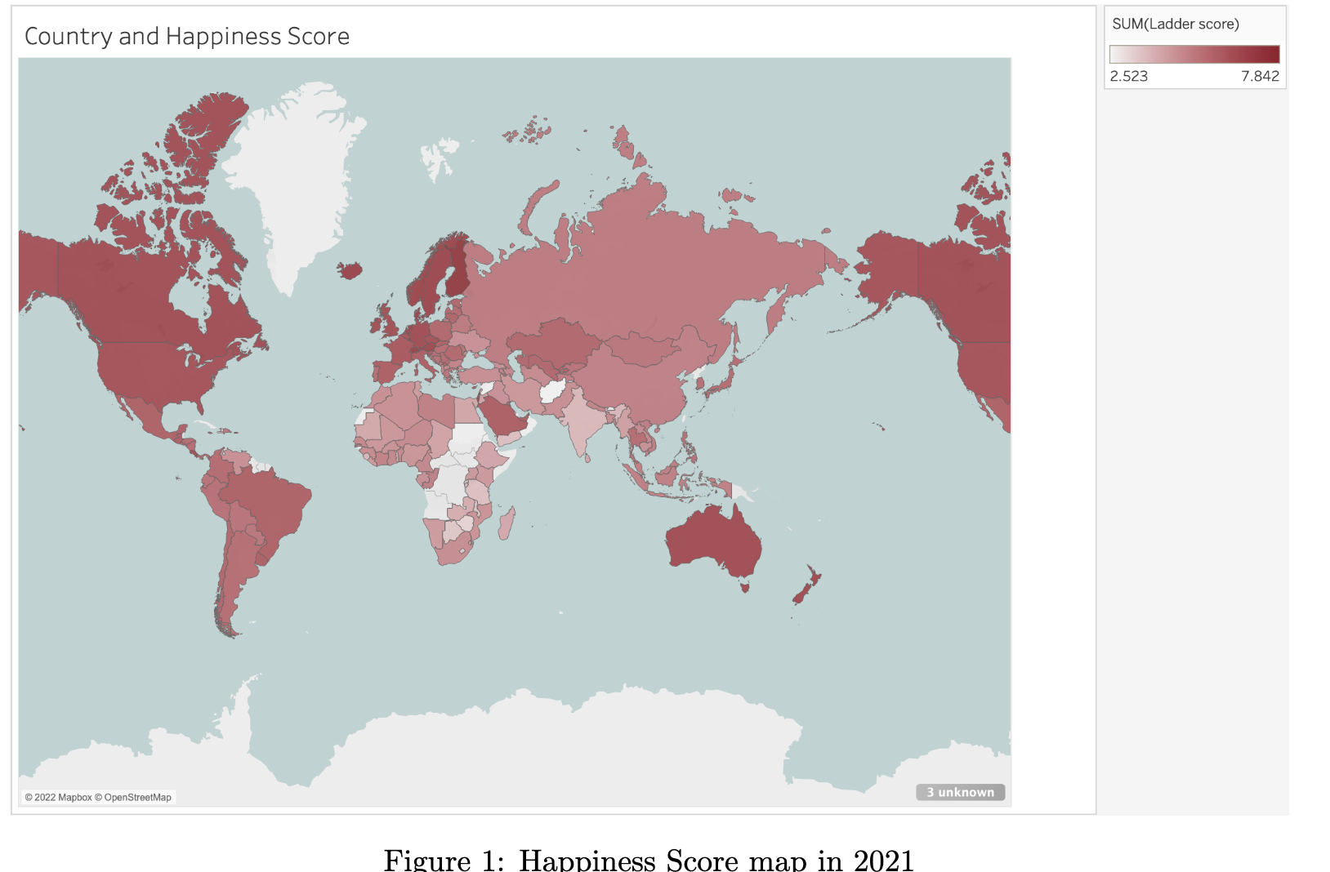
Data Summary and Visualization
Afghanistan, Asia, and Africa have relatively lower happiness scores
North America, Europe and Australia have relatively higher happiness scores.

Slide 5
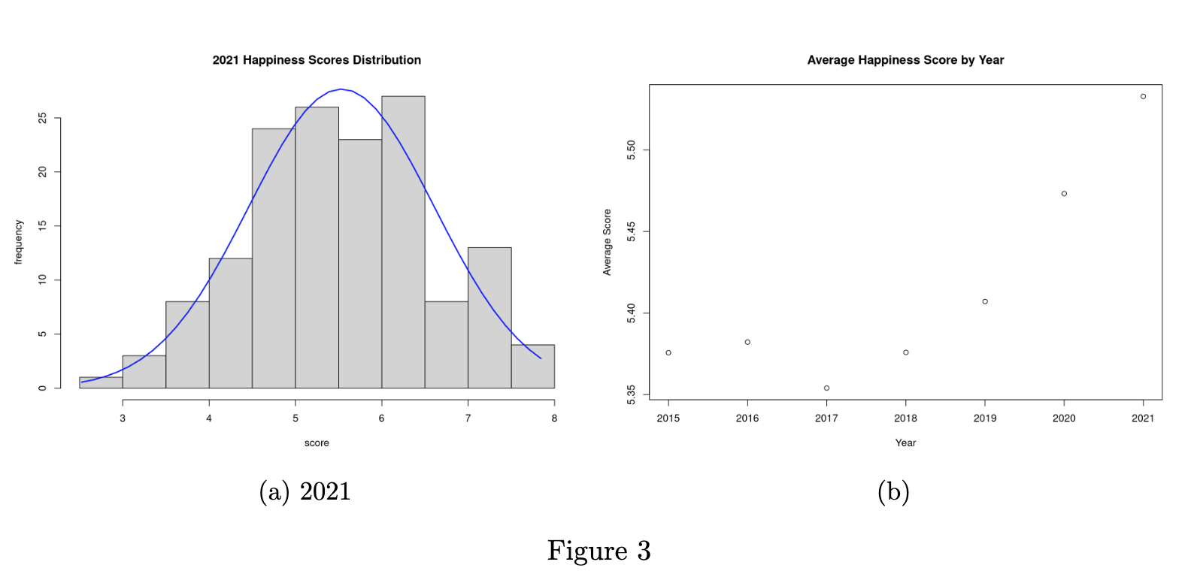
Happiness Score
~Normal distribution
Average happiness score is increasing over years
Range gets larger, but standard deviation reduces

Slide 6
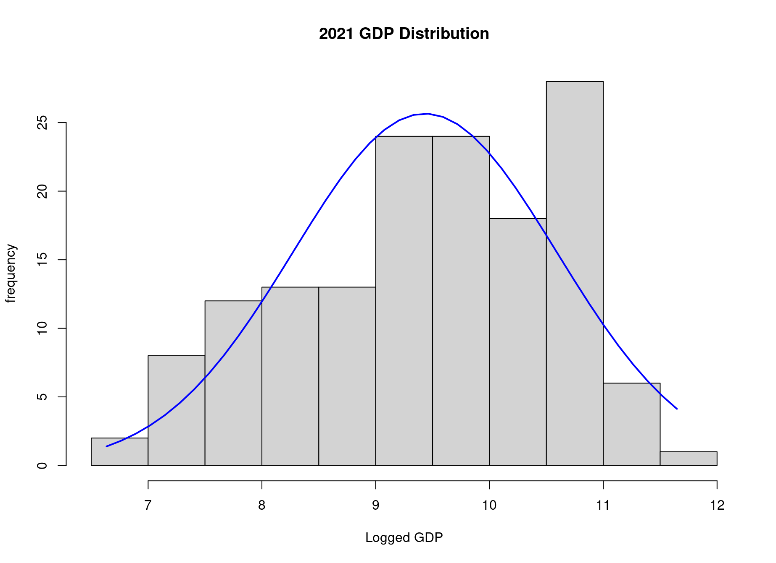
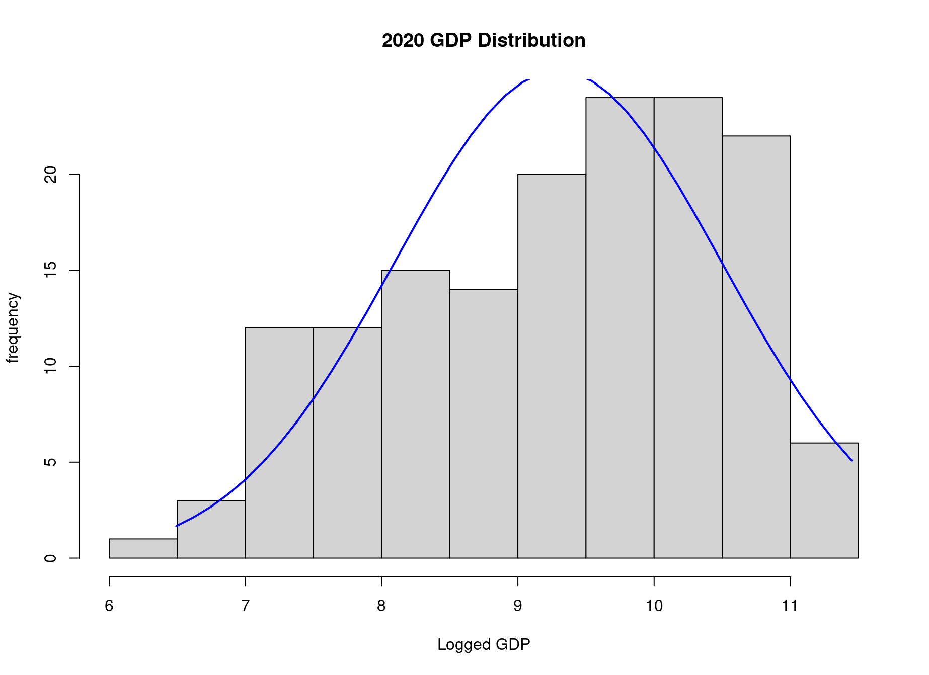
Economic (GDP)
Logged GDP appears to be skewed to the left
The range between poorest and richest countries increased
There is an increase in the average GDP over years

Slide 7
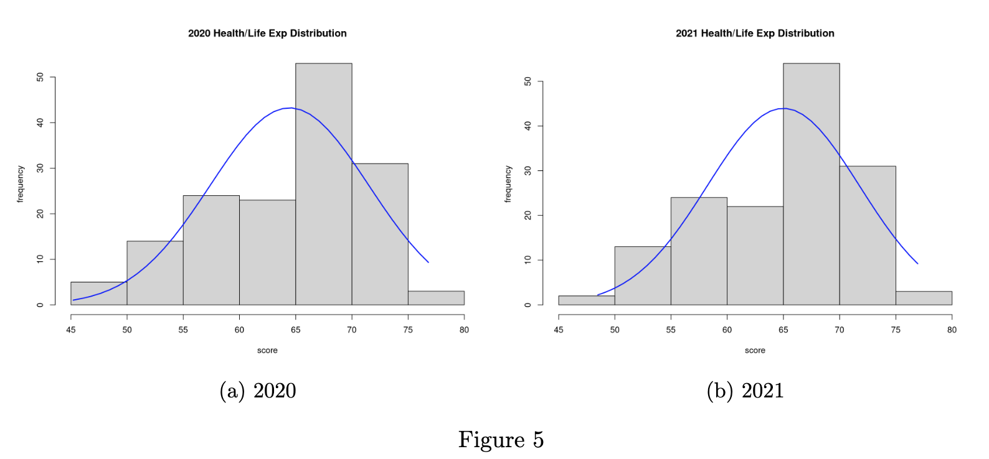
Health (Life Expectancy)
Data appear to be skewed to the left
The average, minimum, maximum life expectancy has all increased

Slide 8
Regression
We would like to predict the happiness score in 2015 by using Economy (GDP per Capita), Family, Health (Life Expectancy), Freedom, Trust (Government Corruption), Generosity and Dystopia Residual.

Slide 9
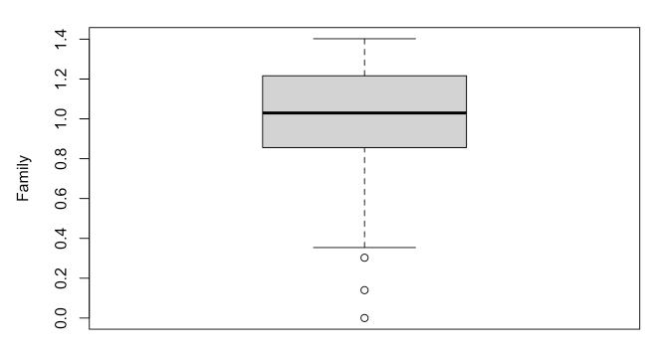
Preprocessing:
Dealing with Missing Values and Outliers:
We use boxplot to drop the points below Q1-1.5*IQR or above Q3+1.5*IQR for every variable. The number of rows drops from 158 to 136 after deleting the outliers.

Slide 10
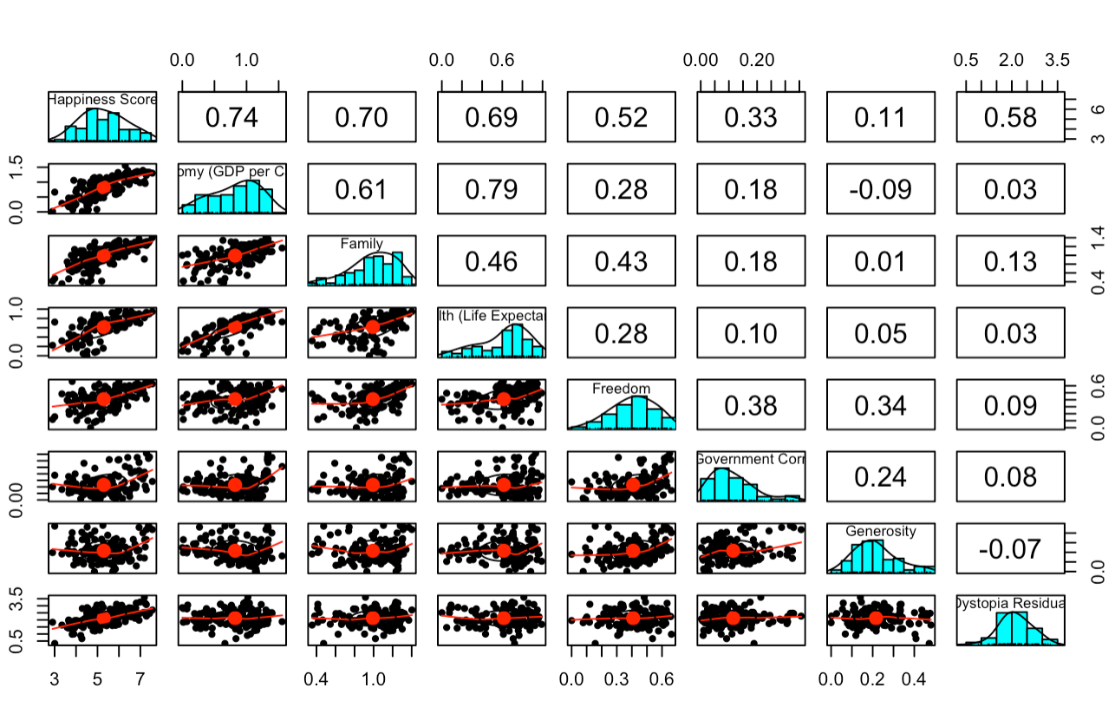
Correlation between all the variables
We can see the scatter plot, bar plot, and correlation index for all the variables in the plot. All the independent variables are related to the happiness score.

Slide 11
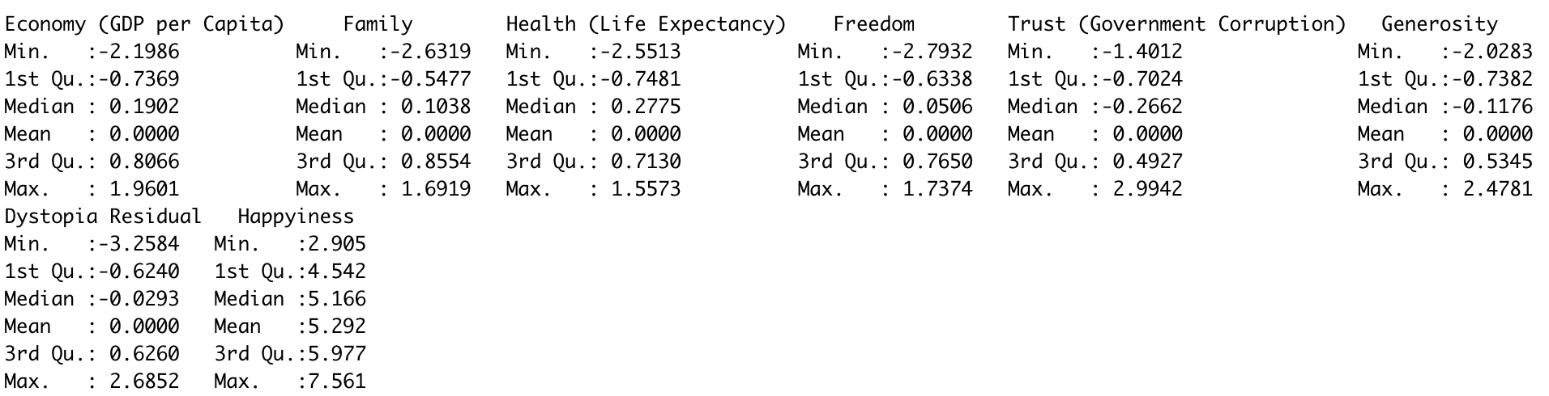
Normalization
We use the scale() function to do the normalization for all the variables except the predicted variable - happiness score. The normalizing of a dataset using the mean value and standard deviation is known as scaling.
summary of the dataset after normalization

Slide 12
Split the Dataset into Training Data and Testing Data
Choose 70% of the data randomly to be the training data, the remaining data to be the testing data.

Slide 13
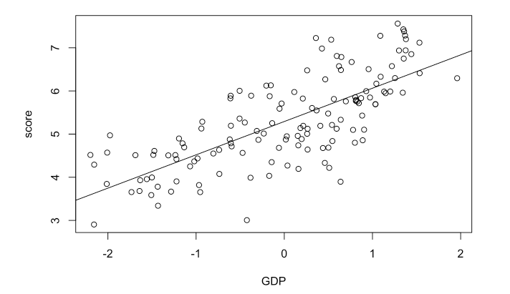
Assumptions
There are four assumptions of linear regression.
1.Linear Relationship - It means there exists a linear relationship between the independent variable, x, and the dependent variable, y.

Slide 14
2. Independence - It means the residuals are independent.
It is not a longitudinal data set so we do not need to worry about independence
assumption. It is “assumed” to be met.
3. Homoscedasticity - It means the residuals have constant variance at every level of x.
4.Normality - It means the residuals of the model are normally distributed.

Slide 15
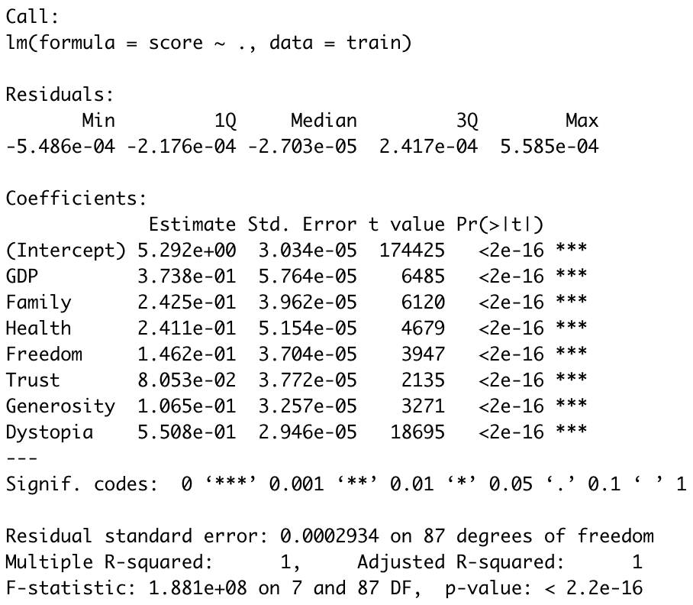
Result of the Model
Summary of the linear regression model
happiness score=
5.292
+0.3738*GDP
+0.2425*Family
+0.2411*Health
+0.1462*Freedom
+0.08053*Trust
+0.1065*Generosity
+0.5508*Dystopia

Slide 17
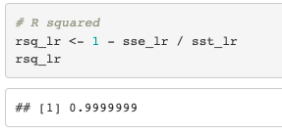
Result of the Model
Summary of the linear regression model
happiness score=
5.292
+0.3738*GDP
+0.2425*Family
+0.2411*Health
+0.1462*Freedom
+0.08053*Trust
+0.1065*Generosity
+0.5508*Dystopia
The r-squared for testing data is 0.99999.., close to 1.

Slide 18
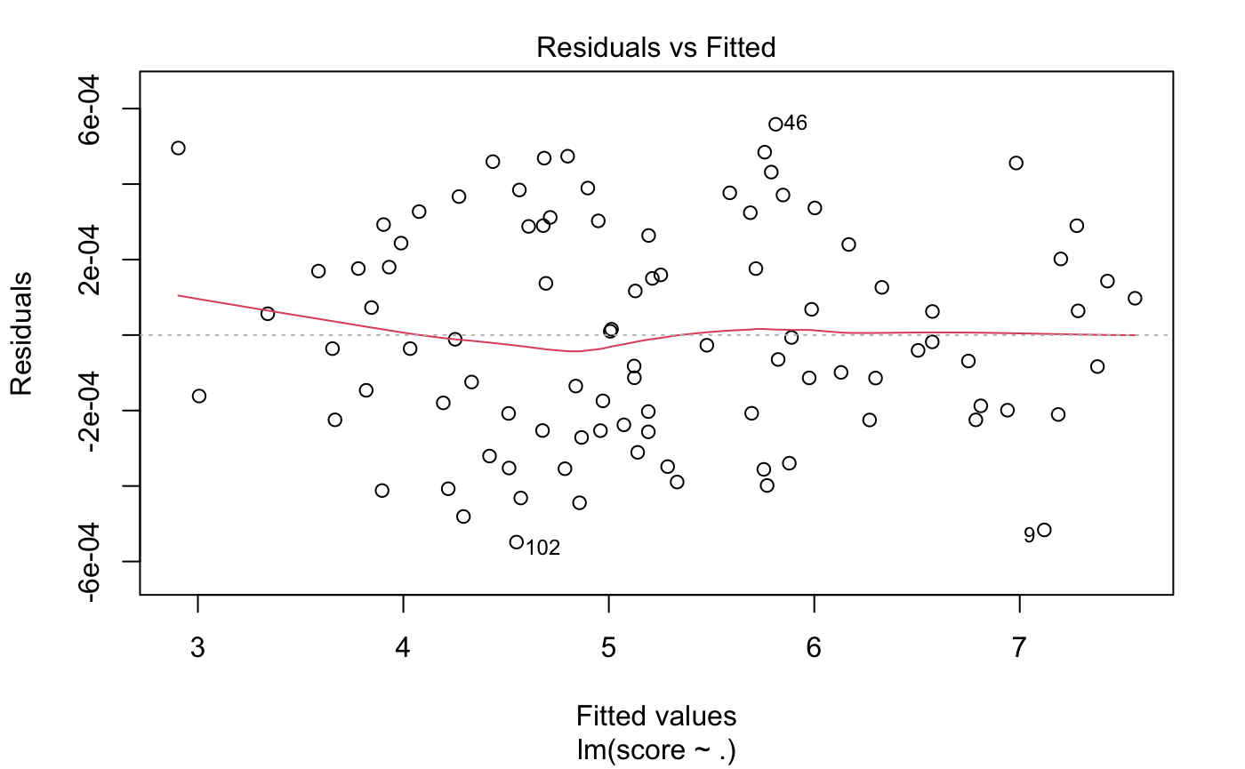
Evaluation of the model:
Residuals vs Fitted:
Equally spread residuals around a horizontal line without distinct patterns, that is a good indication we don’t have non-linear relationships.

Slide 19
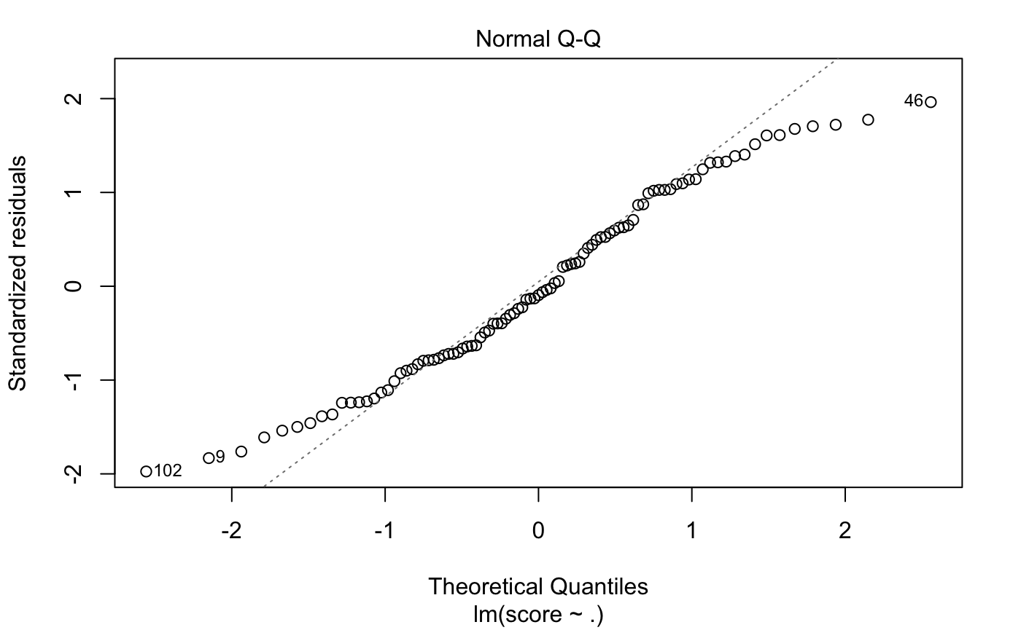
Normal Q-Q:
It’s good if residuals are lined well on the straight dashed line.
Our Q-Q plot is basically good, but the 3 observations look a little off.

Slide 20
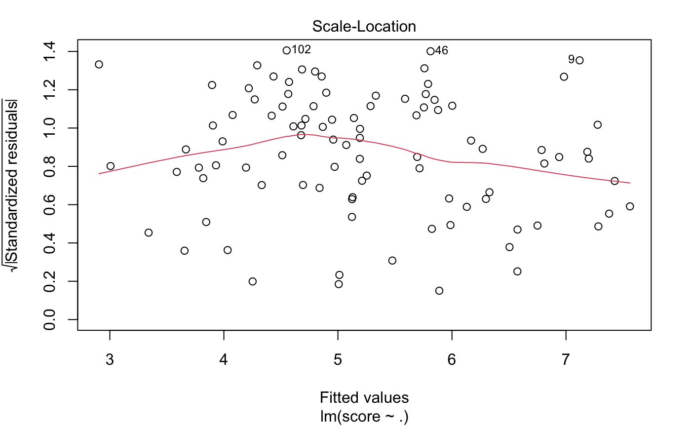
Scale-Location:
This plot shows if residuals are spread equally along the ranges of predictors.
In the Scale-Location plot of our model, the residuals appear randomly spread. The red smooth line is basically horizontal, although not perfect.

Slide 21
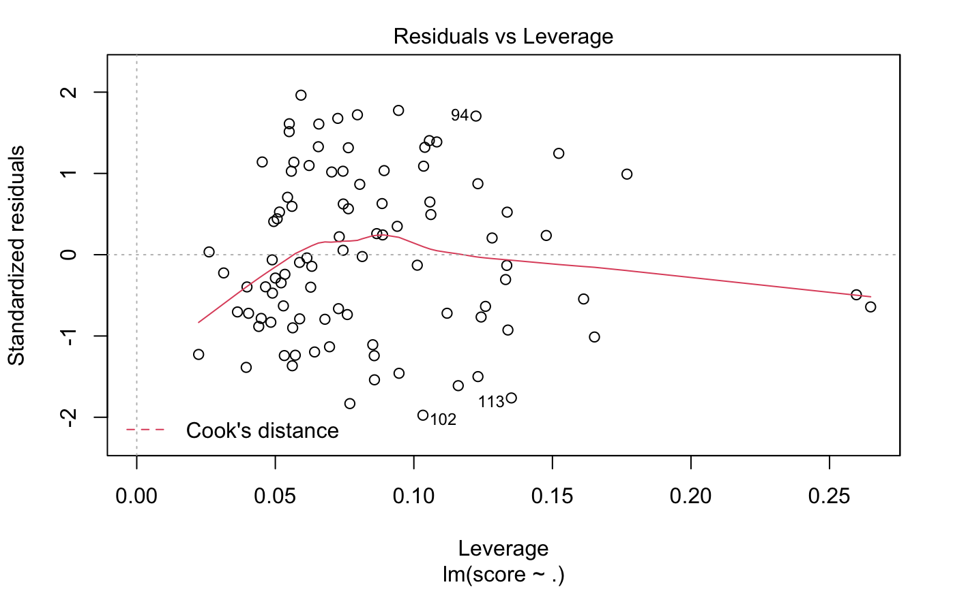
Residuals vs Leverage:
When cases are outside of the Cook’s distance (meaning they have high Cook’s distance scores), the cases are influential to the regression results.
In our Residuals vs Leverage, 3 points are beyond the Cook’s distance lines. But basically it’s good.

Slide 22

ANOVA
In order to perform the analysis between 2017 ,2018 ,2019 happiness scores, we used an analysis of variance (ANOVA) table.
The null hypothesis is H0:μ2017 = μ2018 = μ2019.
Results of ANOVA test

Slide 23
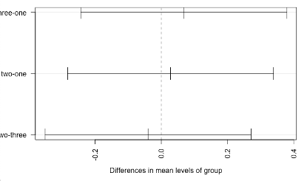
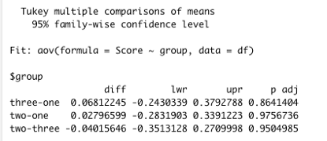
The table above has lwr, upr, and p adjusted columns between each groups. Lwr indicates lower bound of the difference in mean between groups; upr indicates upper bound of the difference in mean between groups; p adj indicated p-value between each group.

Slide 24
Covid Hypothesis Test
Since Covid-19 started in 2020, we suspect that maybe covid-19 may have some negative effect on happiness scores. So, we decided to do a hypothesis test on the happiness score between 2019 and 2020.

Slide 25
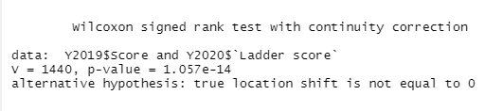
The figure shows the result of the Wilcoxon-signed rank test. Since p-value is less than 0.05, we reject H0. Then we could conclude that covid-19 does have some effects on happiness.
We found out that the score of 2020 is even higher than the score of 2019
We have some assumptions for that:
1.Due to Covid-19, people need to work at home in some countries, so they may have more spare time; thus the happiness score got higher.
2. Covid-19 may have some huge effect on some countries, but most of the countries may not be greatly affected.

Slide 26
Conclusion
1. Visualization:
Relatively lower happiness scores: Asian, Middle-East,Africa
relatively higher happiness scores: North America, Europe, Australia
The average of happiness scores increases by years;
2. From the result of linear regression of 2015, all the seven independent variables are important at 0.05 level of significance.
3. The ANOVA result indicates there is no difference between 2017,2018, 2019 mean of happiness
score since p-value between groups are both grater than 0.05
4. Covid-19 do have some effect on the happiness score. But from the results of the calculation
and the test, there was no evidence that a large difference between the data of those two years
exists.

Slide 27
References
1. Ach´e, Mathurin. "World Happiness Report 2015-2021." Kaggle, 19 Mar. 2021
https://www.kaggle.com/datasets/mathurinache/world-happiness-report-20152021?resource=download
world-happiness-report-20152021?resource=download.
2. Bommae, Written by. "University of Virginia Library Research Data Services
+ Sciences." Research Data Services + Sciences,
https://data.library.virginia.edu/diagnostic-plots/.
3. Finnstats. "How to Perform Tukey HSD Test in R: R-Bloggers." R, 28 Aug. 2021,
http://www.r-bloggers.com/2021/08/how-to-perform-tukey-hsd-test-in-r/.
4. "Paired Samples Wilcoxon Test in R." STHDA,
http://www.sthda.com/english/wiki/paired-samples-wilcoxon-test-in-r.

